Slide 1



TeamWork Project Team: Tasmanian Devil
Our project: Battleship game
Boyko Georgiev
http://bgeorgiev.com
Bojidar Penchev
http://penchev.telerik-students.org
Denis Georgiev
http://denisgeorgiev.cloudvps.bg
Nikolay Kutlev
http://nkutlev.wordpress.com
Slav Yanev
Email : syyanev@gmail.com

Slide 2
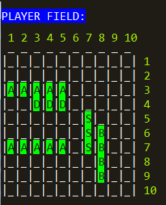
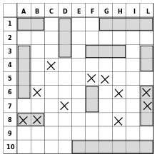
Introduction
Our project – Game Battleship
The Field of the game is with 100 cells (realized with Matrix),
10 Columns
10 Rows
=
2

Slide 3
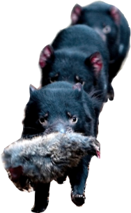
Content
Object Oriented Assets
4 Interfaces
18 Classes
2 Abstract Class
1 Exception Class
1 Enumeration
Notes:
(c) 2006 National Academy for Software Development - http://academy.devbg.org*
3##

Slide 4
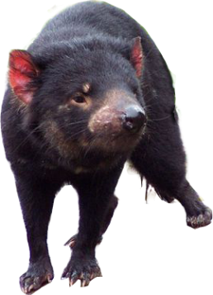
Game
The Game has two players – Human vs. Computer
Game starts with random 10 vessels:
Battle Ships (B) – 4 cells
Destroyers (D) – 3 cells
Submarines (S) – 3 cells
Patrol Boats (P) – 2 cells
Aircraft Carrier (A) – 5 cells
4

Slide 5
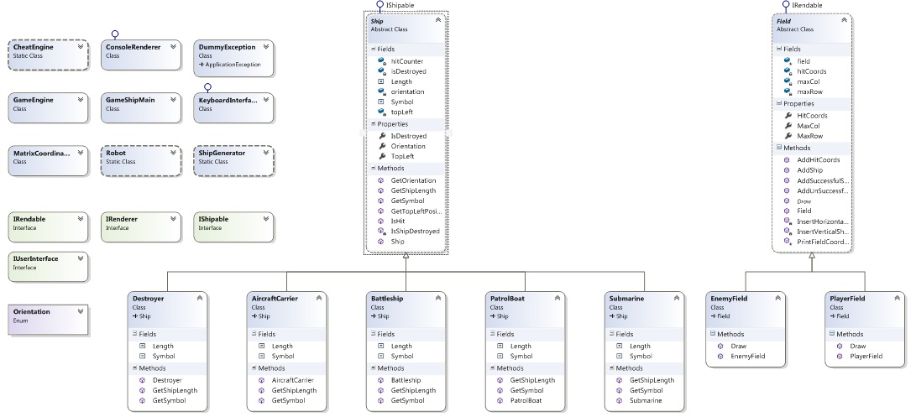
Class Diagram
Class Hierarchy

Slide 6
The end
Thank you for your attention!

